Slide 1
计算机视觉：模型、学习与推理
第四章 概率模型拟合
Fitting probability models
Notes:
参考： Prof. Simon J.D. Prince’s Powerpoint slides http://www.computervisionmodels.com/

Slide 2
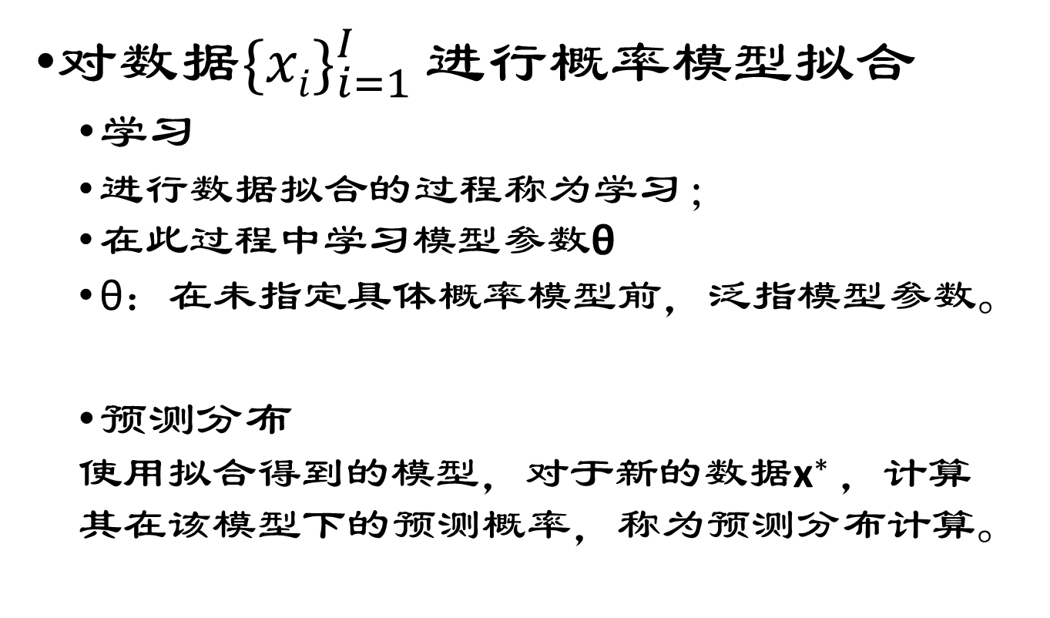
概率模型拟合
对数据${\{xi\}}_{i=1}^{I}$ 进行概率模型拟合
学习
进行数据拟合的过程称为学习；
在此过程中学习模型参数θ
θ：在未指定具体概率模型前，泛指模型参数。
预测分布
使用拟合得到的模型，对于新的数据x∗ ，计算其在该模型下的预测概率，称为预测分布计算。
Notes:
Fitting probability models to data ${\{xi\}}_{}^{I}$_{i =1}
This process is referred to as learning because we learn about the parameters θ of the model
It also concerns calculating the probability of a new datum x∗ under the resulting model. This is known as evaluating the predictive distribution.

Slide 3
本章结构
拟合概率分布(Fitting probability distributions)
最大似然（Maximum likelihood）
最大后验（Maximum a posteriori）
贝叶斯方法（Bayesian approach）
实例之一，Normal distribution
实例之二，Categorical distribution
介绍三种方法
3
Notes:
This chapter concerns fitting probability models to data {xi}Ii =1. This process is referred to as learning because we learn about the parameters θ of the model1. It also concerns calculating the probability of a new datum x∗ under the resulting model. This is known as evaluating the predictive distribution. We consider three methods: maximum likelihood, maximum a posteriori and the Bayesian approach.

Slide 4
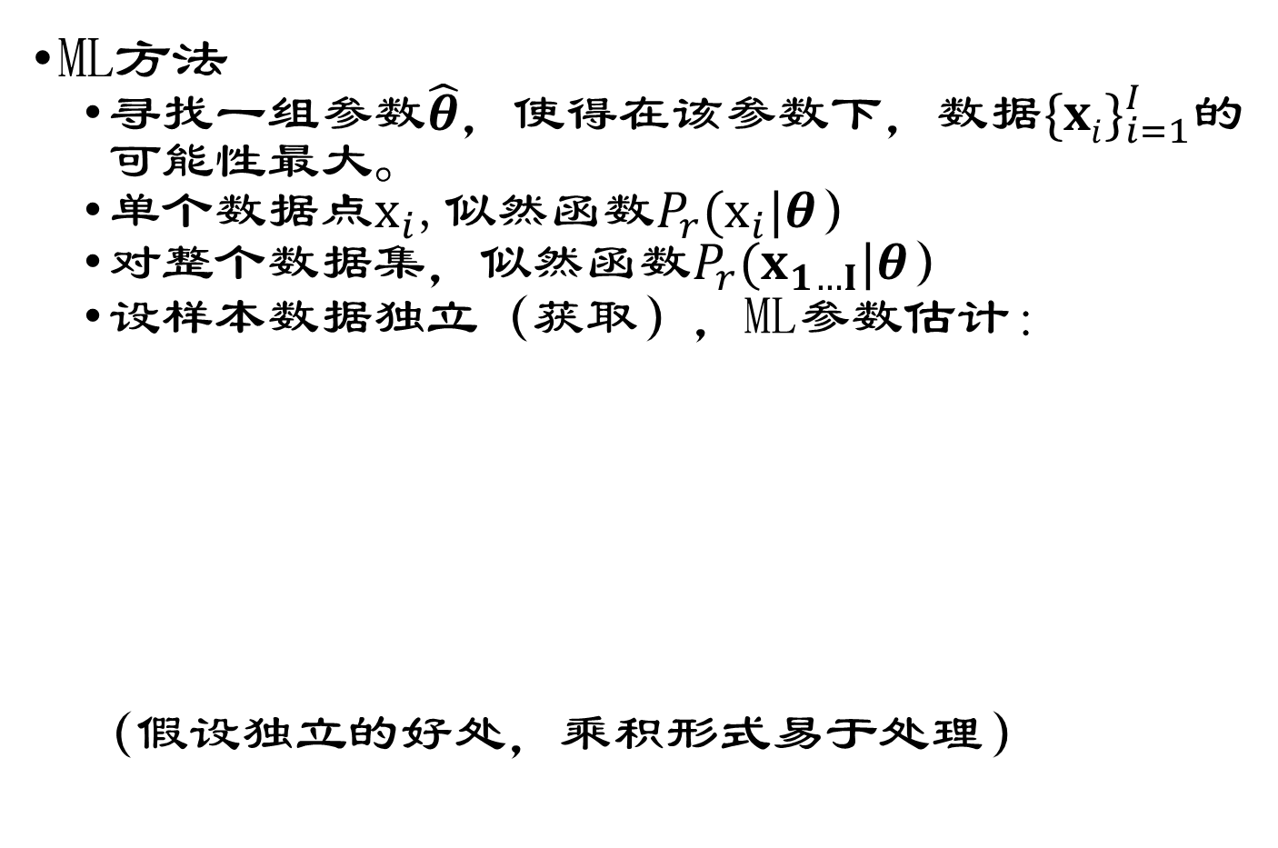
最大似然方法（ML）
ML方法
寻找一组参数$\hat{θ}$，使得在该参数下，数据${\{xi\}}_{i=1}^{I}$的可能性最大。
单个数据点$x_{i}$,似然函数$P_{r}(x_{i}|θ）$
对整个数据集，似然函数$P_{r}(x_{1…I}|θ）$
设样本数据独立（获取），ML参数估计：
（假设独立的好处，乘积形式易于处理）
Notes:
To calculate the likelihood
function Pr(xij) at a single data point xi, we simply evaluate the probability density
function at xi. Assuming each data point was drawn independently from the
distribution, the likelihood function Pr(x1:::I j) for a set of points is the product
of the individual likelihoods. Hence, the ML estimate of the parameters is

Slide 5
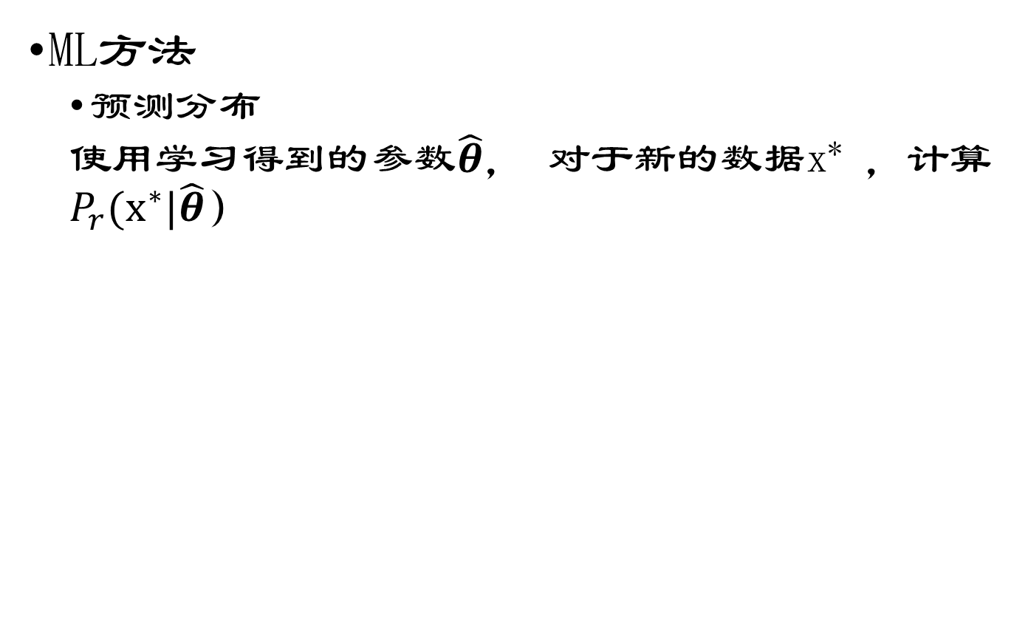
最大似然方法（ML）
ML方法
预测分布
使用学习得到的参数$\hat{θ}$， 对于新的数据x∗ ，计算$P_{r}(x^{∗}|\hat{θ}）$
Notes:
As the name suggests, the maximum likelihood (ML) method nds the set of parameters
^
under which the data fxigI
i=1 are most likely. To calculate the likelihood
function Pr(xij) at a single data point xi, we simply evaluate the probability density
function at xi. Assuming each data point was drawn independently from the
distribution, the likelihood function Pr(x1:::I j) for a set of points is the product
of the individual likelihoods. Hence, the ML estimate of the parameters is

Slide 6
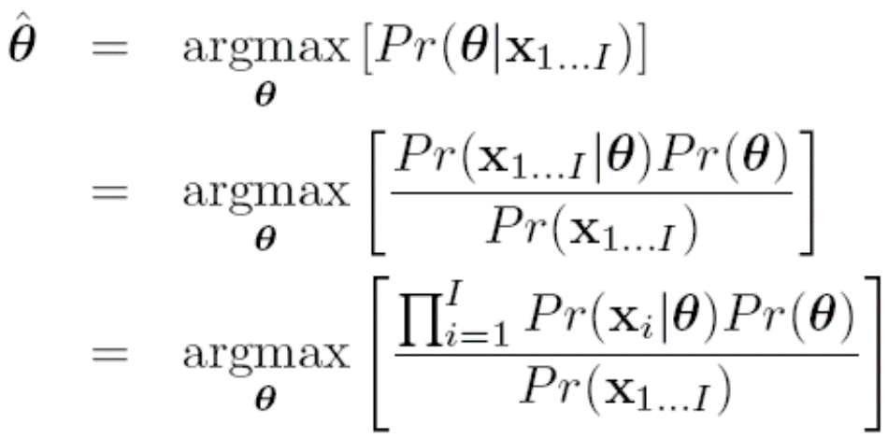
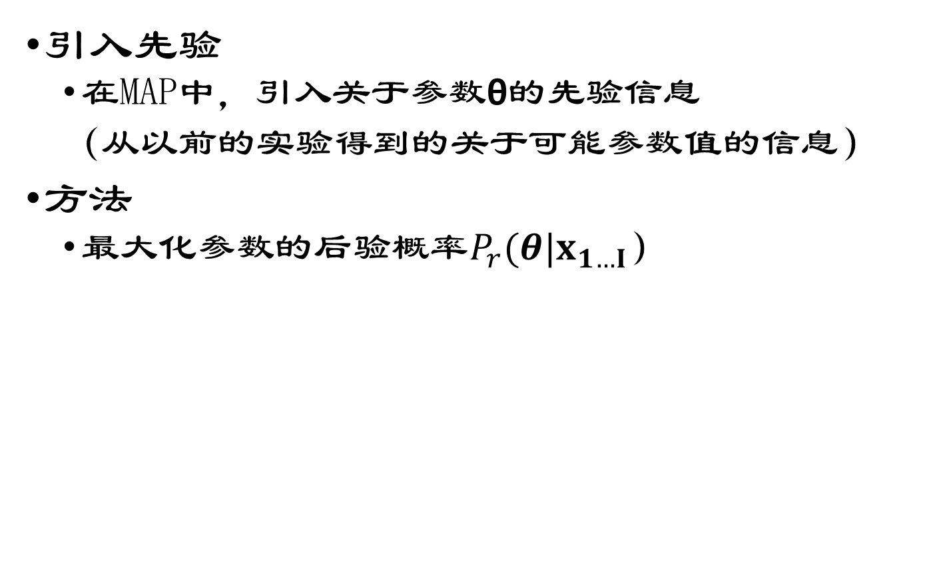
最大后验方法（MAP）
引入先验
在MAP中，引入关于参数θ的先验信息
（从以前的实验得到的关于可能参数值的信息）
方法
最大化参数的后验概率$P_{r}(θ|x_{1…I}）$
1.贝叶斯公式
2.独立假设
Notes:
In maximum a posteriori (MAP) fitting, we introduce prior information about the parameters θ. From previous experience we may know something about the possible parameter values. For example, in a time-sequence the values of the parameters at time t tell us a lot about the possible values at time t + 1, and this information would be encoded in the prior distribution.
As the name suggests, maximum a posteriori estimation maximizes the posterior probability Pr(jx1:::I ) of the parameters

Slide 7

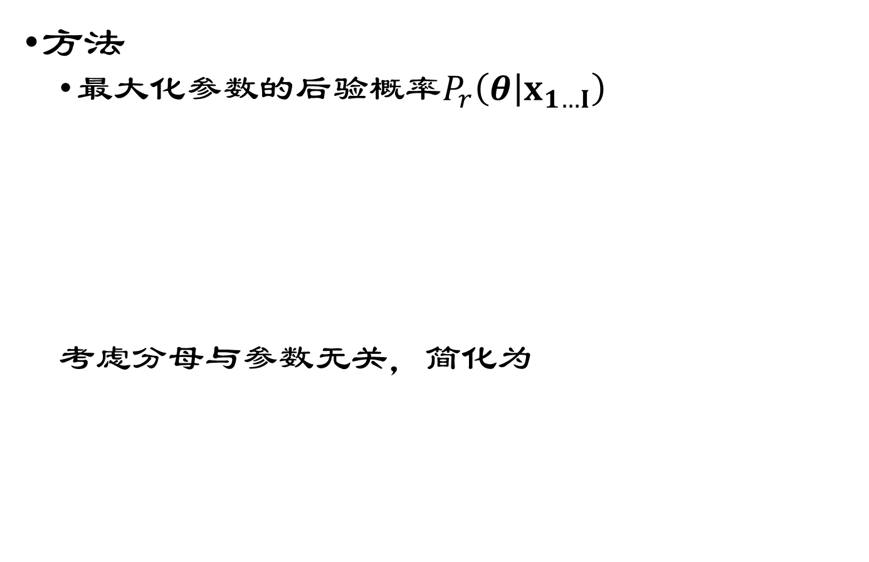
最大后验方法（MAP）
方法
最大化参数的后验概率$P_{r}\left(θ | x_{1…I}\right)$
考虑分母与参数无关，简化为

Slide 8
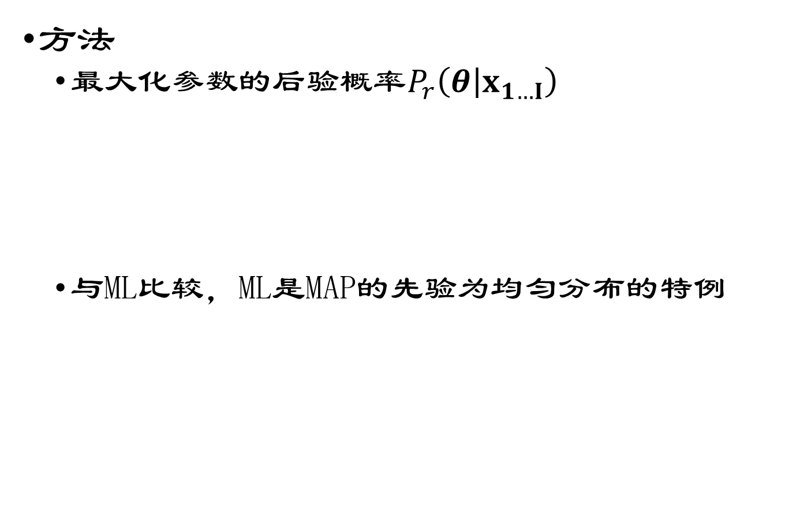
最大后验方法（MAP）
方法
最大化参数的后验概率$P_{r}\left(θ | x_{1…I}\right)$
与ML比较，ML是MAP的先验为均匀分布的特例
ML方法
Notes:
Comparing this to the maximum likelihood criterion (equation 4.1) we see that it is identical except for the additional prior term; maximum likelihood is a special case of maximum a posteriori where the prior is uninformative.
The predictive density (probability of a new datum x under the fitted model) is again calculated by evaluating the pdf Pr(xj^ ) using the new parameters.

Slide 9
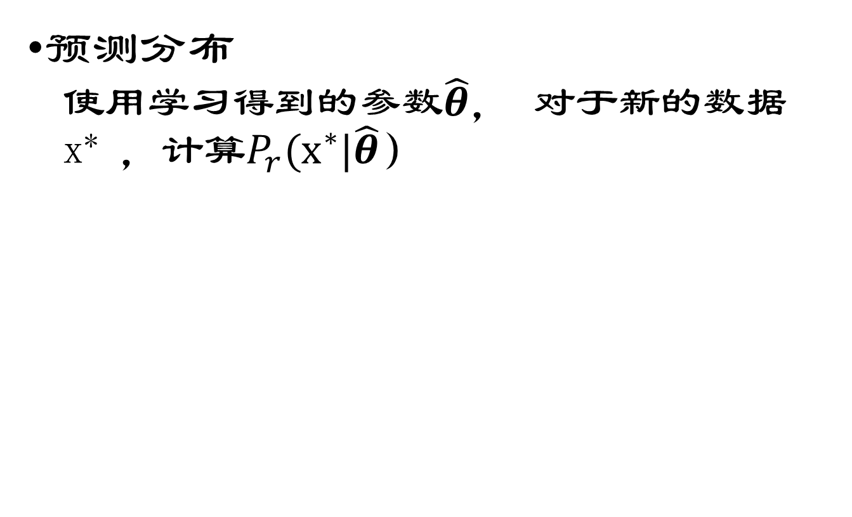
最大后验方法（MAP）
预测分布
使用学习得到的参数$\hat{θ}$， 对于新的数据x∗ ，计算$P_{r}(x^{∗}|\hat{θ}）$
Notes:
The predictive density (probability of a new datum x under the fitted model) is again calculated by evaluating the pdf Pr(xj^ ) using the new parameters.

Slide 10
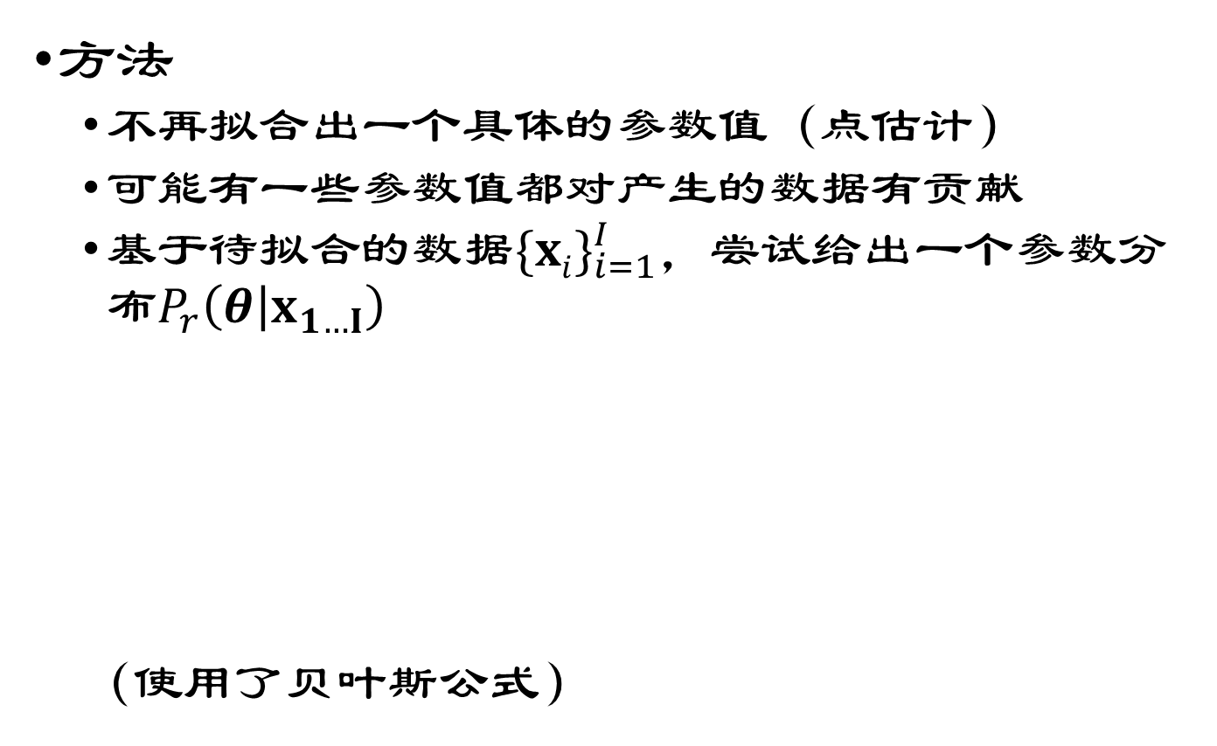
贝叶斯方法
方法
不再拟合出一个具体的参数值（点估计）
可能有一些参数值都对产生的数据有贡献
基于待拟合的数据${\{xi\}}_{i=1}^{I}$，尝试给出一个参数分布$P_{r}\left(θ | x_{1…I}\right)$
（使用了贝叶斯公式）
Notes:
In the Bayesian approach we stop trying to estimate single fixed values (point estimates) of the parameters and admit what is obvious; there may be many values of the parameters that are compatible with the data. We compute a probability distribution Pr(jx1:::I ) over the parameters based on data fxigI i=1 using Bayes‘ rule so that

Slide 11
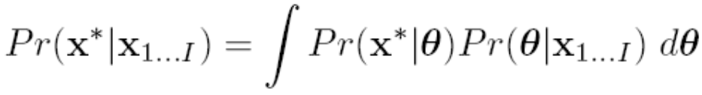
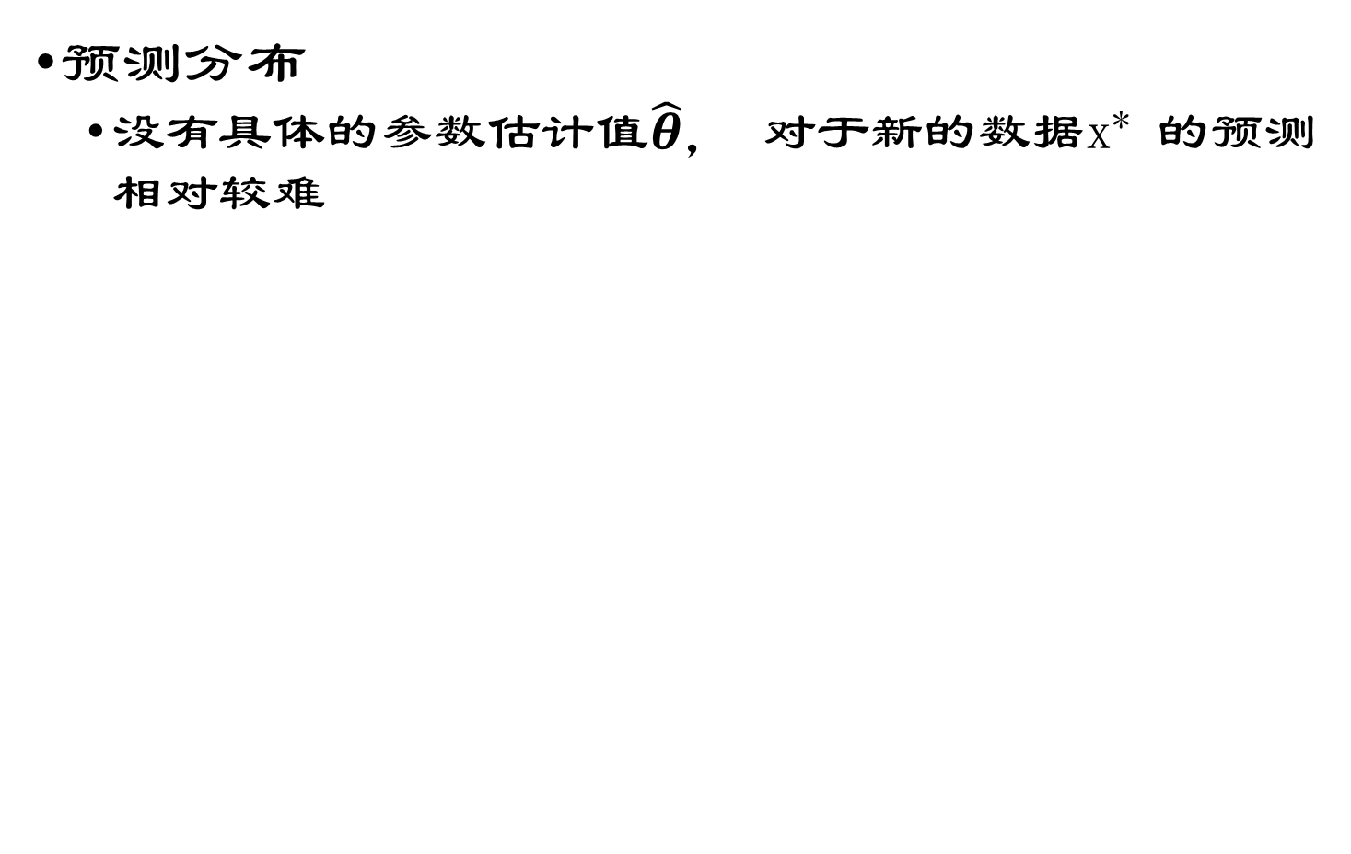
贝叶斯方法
预测分布
没有具体的参数估计$值\hat{θ}$， 对于新的数据x∗ 的预测相对较难
整个积分可视为加权平均
具体参数下的预测
参数的后验分布，表示我们对参数的置信度，作为权值使用。
Notes:
Evaluating the predictive distribution is more difficult for the Bayesian case since we have not estimated a single model but have instead found a probability distribution over possible models. Hence, we calculate
which can be interpreted as follows: the term Pr(xj) is the prediction for a given value of . So, the integral can be thought of as a weighted sum of the predictions given by dierent parameters , where the weighting is determined by the posterior probability distribution Pr(jx1:::I ) over the parameters (representing our condence that dierent parameters are correct).

Slide 12
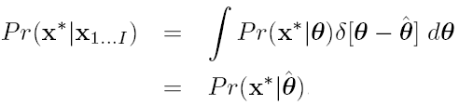
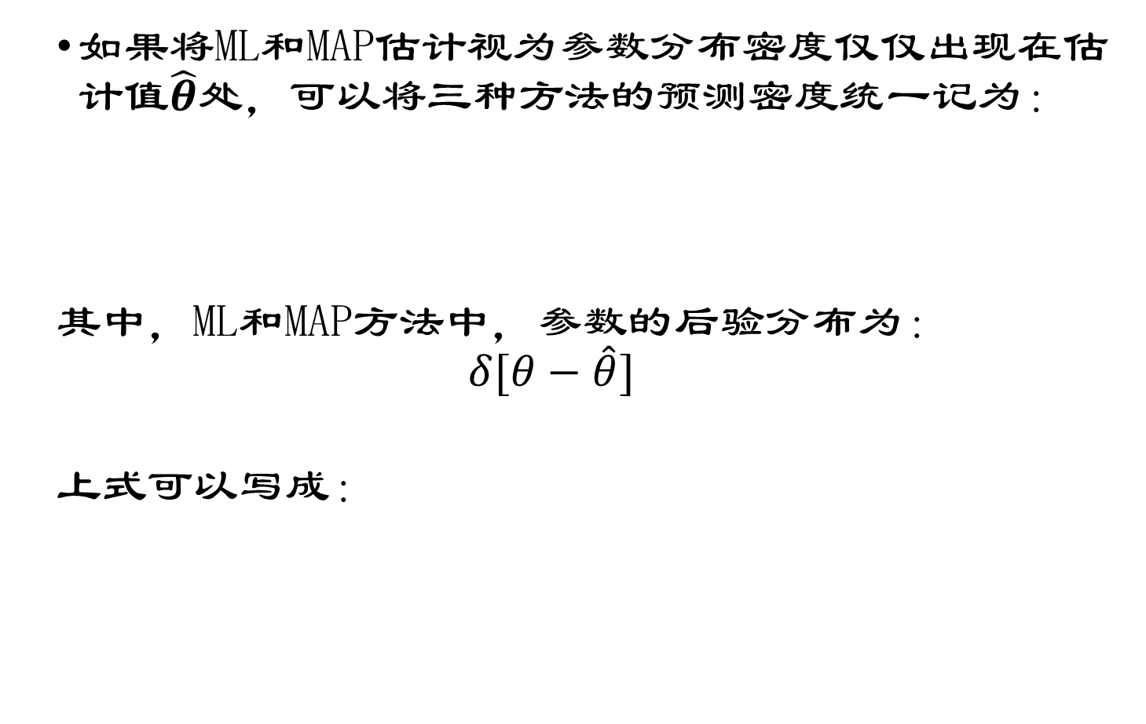
三种方法下的预测
如果将ML和MAP估计视为参数分布密度仅仅出现在估计$值\hat{θ}$处，可以将三种方法的预测密度统一记为：
其中，ML和MAP方法中，参数的后验分布为：
$$δ[θ−\hat{θ}]$$
上式可以写成：
Notes:
The predictive density calculations for the Bayesian, MAP and ML cases can be unied if we consider the ML and MAP estimates to be special probability distributions over the parameters where all of the density is at ^. More formally, we can consider them as delta functions centered at ^. A delta function [z] is a function that integrates to one, and that returns zero everywhere except at z = 0.
We can now write

Slide 13
本章结构
拟合概率分布(Fitting probability distributions)
最大似然（Maximum likelihood）
最大后验（Maximum a posteriori）
贝叶斯方法（Bayesian approach）
实例之一，正态分布
实例之二，分类分布
13
Notes:
This chapter concerns fitting probability models to data {xi}Ii =1. This process is referred to as learning because we learn about the parameters θ of the model1. It also concerns calculating the probability of a new datum x∗ under the resulting model. This is known as evaluating the predictive distribution. We consider three methods: maximum likelihood, maximum a posteriori and the Bayesian approach.

Slide 14
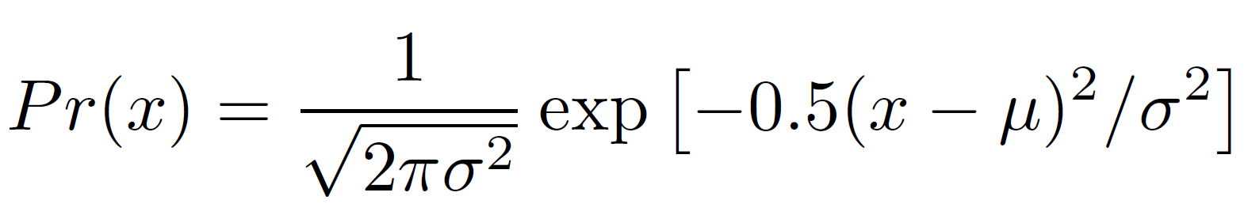
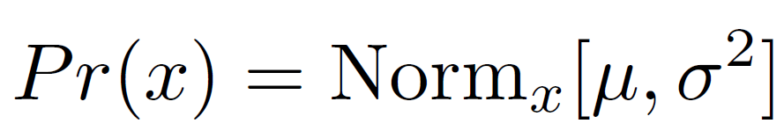
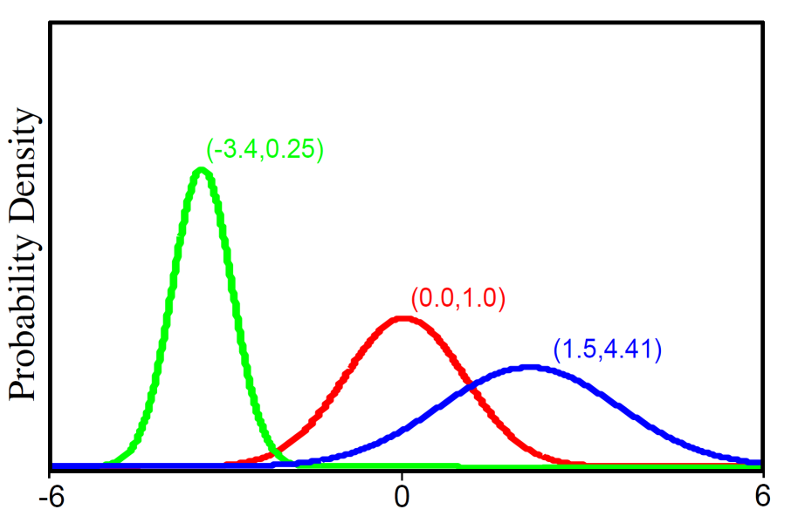
单变量正态分布例
简记为：
单变量正态分布描述单个连续变量，2个参数: μ , σ²>0
Notes:
To illustrate the above ideas, we will consider fitting a univariate normal model to scalar data {xi}Ii=1.

Slide 15
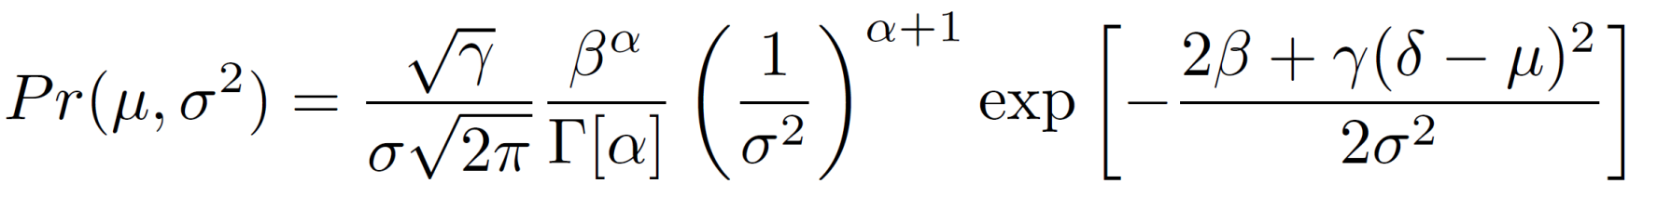
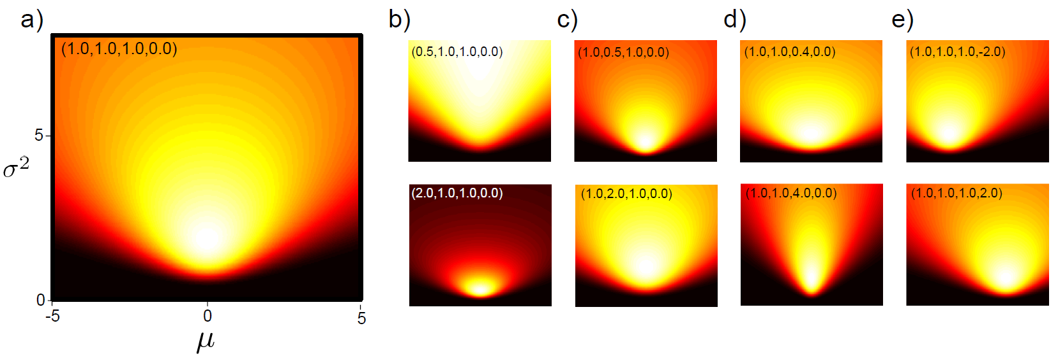
单变量正态分布例
正态逆伽马分布
2个随机变量 μ， σ²>0
简记为：
4个参数 α, β, γ > 0 ，δ.
15

Slide 16
单变量正态分布例
对同一问题使用三种不同方法：
ML 参数学习
MAP 参数学习
参数分布贝叶斯学习
是否会得到相同的结果？
Notes:
Approach the same problem 3 different ways:
Learn ML parameters
Learn MAP parameters
Learn Bayesian distribution of parameters
Will we get the same results?

Slide 17
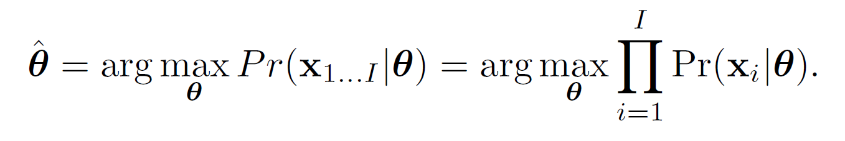
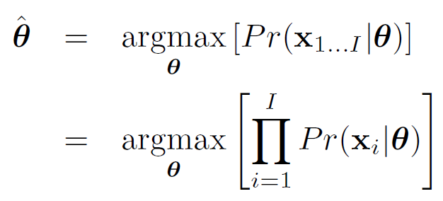
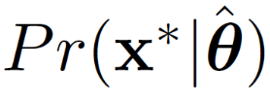
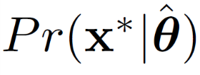
1. 最大似然方法（ Maximum Likelihood ）
拟合: 如名所述，寻找一组参数，使得数据 发生的可能性最大。
假设数据是独立的(故可以用乘积的形式)
密度预测（Predictive Density）:
用此组参数下的概率分布计算新数据 的概率密度
Notes:
As the name suggests, the maximum likelihood (ML) method finds the set of parameters ˆθ under which the data {xi}Ii =1 are most likely.
To calculate the likelihood function Pr(xi|θ) at a single data point xi we simply evaluate the probability density function at xi. Assuming each data point was drawn independently from the distribution, the likelihood function Pr(x1...I |θ) for a set of points is the product of the individual likelihoods. Hence, the ML estimate of the parameters is

Slide 18
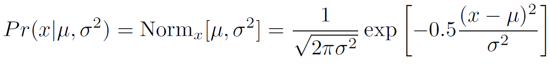
正态分布拟合: ML
拟合: 如名所述，寻找一组参数，使得数据 发生的可能性最大。
由其pdf给定的似然

Slide 19
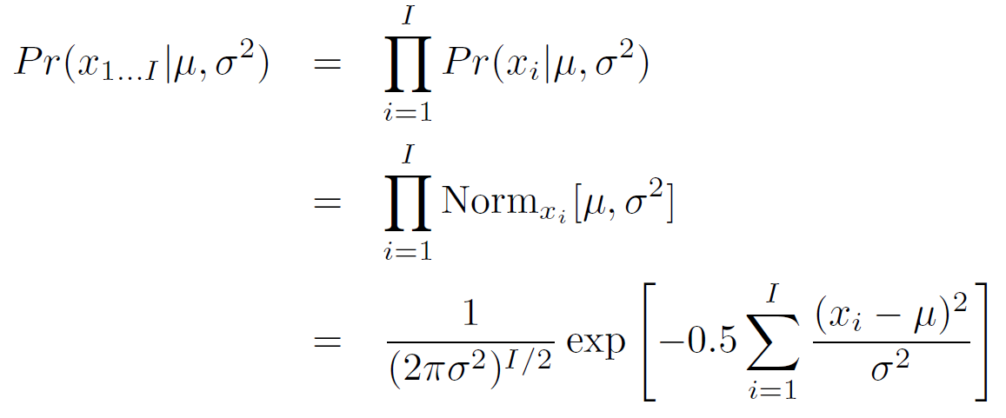
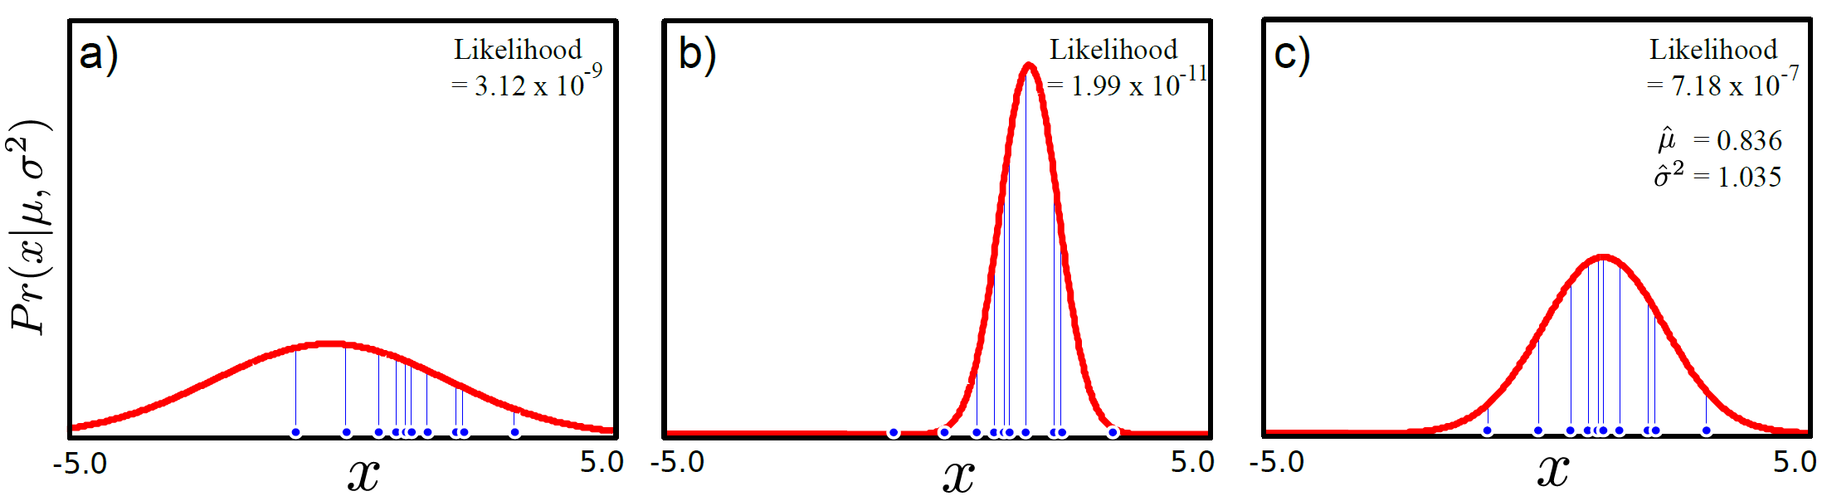
正态分布拟合: ML
Notes:
Figure 4.1 Maximum likelihood fitting. The likelihood of the parameters for a single datapoint is the height of the pdf evaluated at that point (blue vertical lines). The likelihood of a set of independently sampled data is the product of the individual likelihoods. a) The likelihood for this normal distribution is low because the large variance means the height of the pdf is low everywhere. b) The likelihood for this normal distribution is even lower as the left-most datum is very unlikely under the model. c) The maximum likelihood solution is the set of parameters for which the likelihood is maximized.
图中标出的likelihood值，应该是取对应参数值时所有样本联合分布的似然值，最右边是在此估计值下似然最大。
Figure 4.1 shows a set of data points and three possible fits to the data. The mean of the maximum likelihood t is the mean of the data. The ML t is neither too narrow (giving very low probabilities to the furthest data points from the mean) nor too wide (resulting in a at distribution and giving low probability to all points).

Slide 20
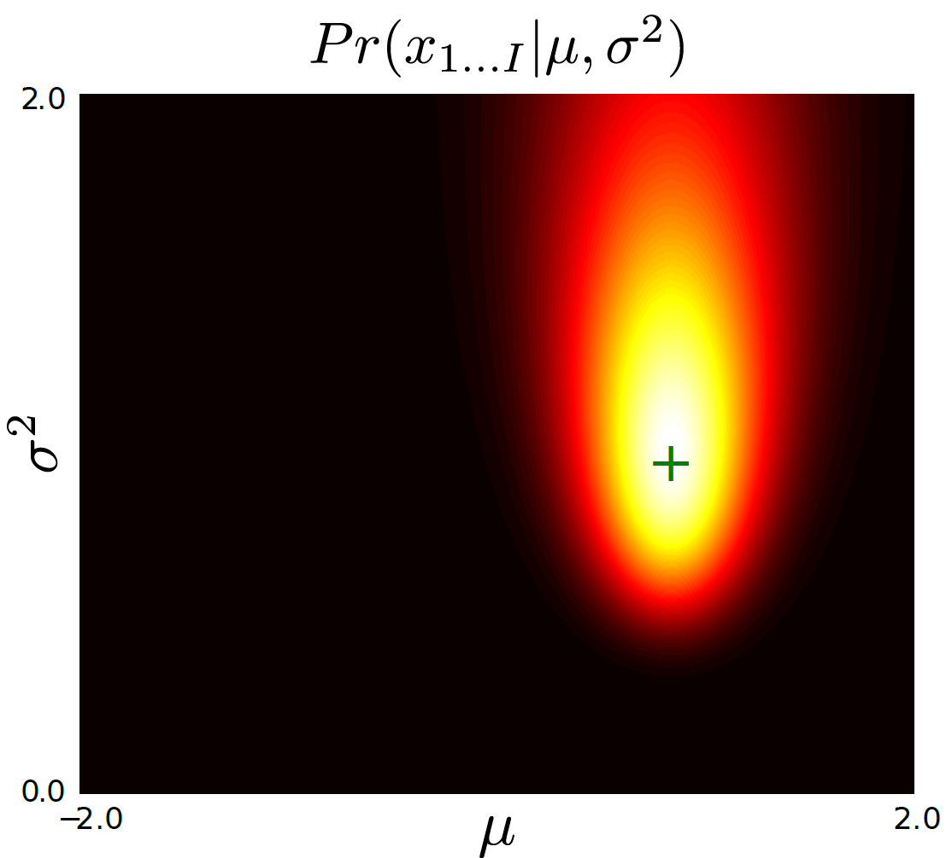
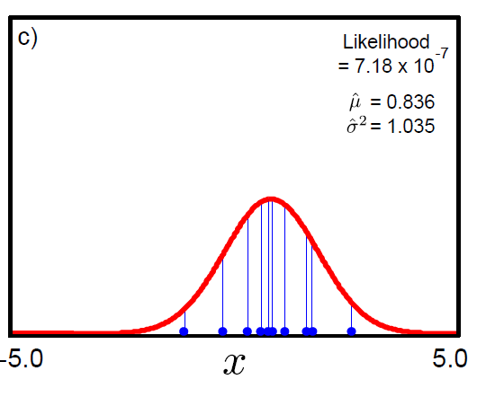
正态分布拟合: ML
Plotted surface of likelihoods as a function of possible parameter values
ML Solution is at peak
Notes:
Figure 4.2 The likelihood function for a fixed set of observed data is a function of the mean μ and variance σ2 parameters.
The plot shows that there are many parameter settings which might plausibly be responsible for the ten data points from figure 3.1. A sensible
choice for the “best” parameter setting is the maximum likelihood solution (green cross) which corresponds to the maximum of this function.

Slide 21
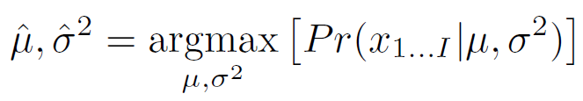
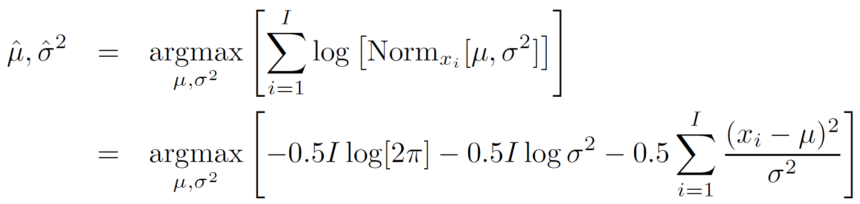
正态分布拟合: ML
代数方法:
式中，
用最大化其对数形式替换：

Slide 22
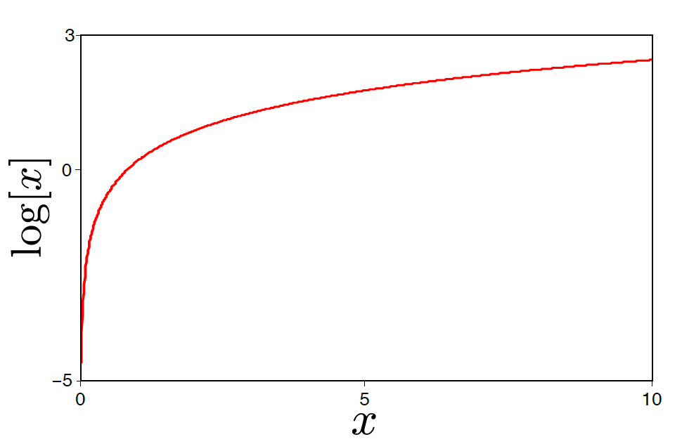
为什么采用取对数的方法?
取对数为单调变换
函数在取对数前后峰值位置相同
而对数似然更容易处理
Notes:
Figure 4.3 The logarithm is a monotonic transformation: if one point is higher than another then it will also be higher after transformation by the logarithmic function. It follows that if we transform the surface in figure 3.2 through the logarithmic function, the maximum will remain in the same position.

Slide 23
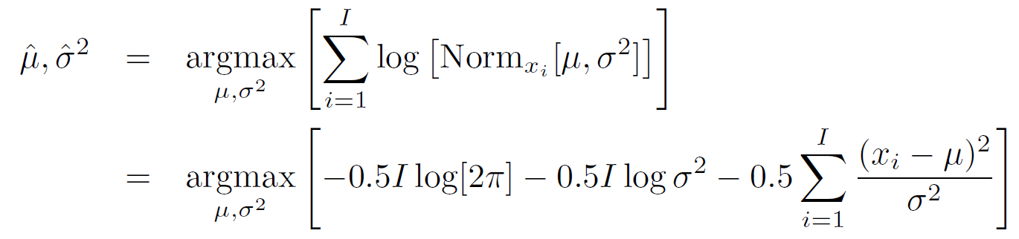
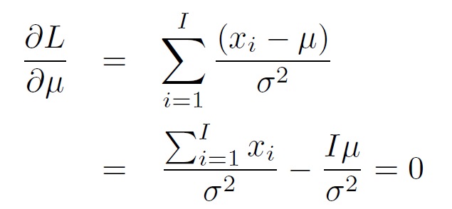
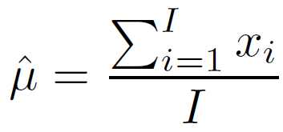
正态分布拟合: ML
如何最大化一个函数？ 求导并置零
解为：

Slide 24
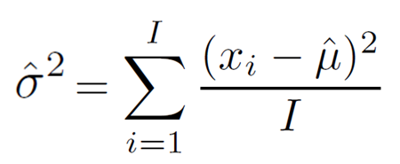
正态分布拟合: ML
最大似然解为：
似曾相识！
Notes:
These expressions are hardly surprising, but the same idea can be used to estimate parameters in other distributions where the results are less familiar. Figure 3.1 shows a set of data points and three possible fits to the data. The mean of the maximum likelihood fit is the mean of the data. The ML fit is neither too narrow (giving very low probabilities to the furthest data points from the mean) nor too wide (resulting in a flat distribution and giving low probability to all points).

Slide 25
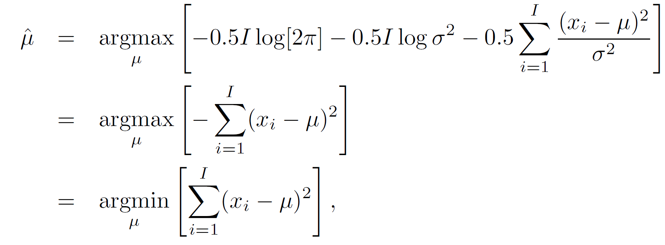
最小二乘方法
正态分布的最大似然...
从第一行到第二行，
达到max，只与第三项有关，所以将第三项的常数去掉（与最大化无关的），即是此式。
...给出了最小二乘拟合的准则
25

Slide 26
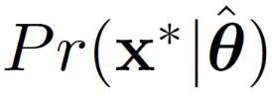
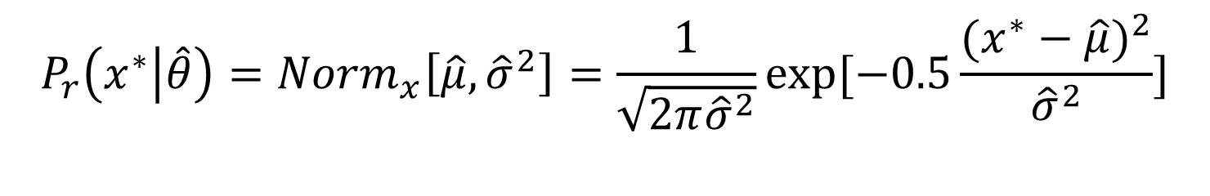
ML方法下的预测密度
最大似然法:
基于ML得到的分布参数，计算新数据 的概率分布
$$P_{r}\left(x^{∗} | \hat{θ}\right)={Norm}_{x}\left[\hat{μ},{\hat{σ}}^{2}\right]=\frac{1}{\sqrt{2π{\hat{σ}}^{2}}}exp⁡[−0.5\frac{{(x^{∗}−\hat{μ})}^{2}}{{\hat{σ}}^{2}}]$$
Notes:
关于预测的对比与理解

Slide 27
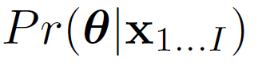
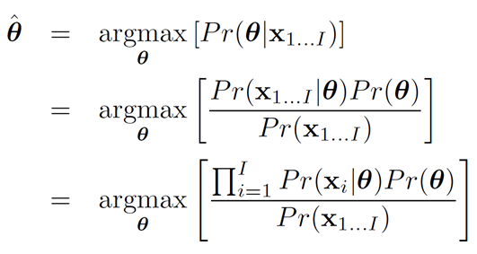
2. 最大后验概率方法 Maximum a posteriori (MAP)
拟合：如命题所述，寻找一组参数使得后验概率
最大。
考虑了先验知识
这里，假设数据独立。
Notes:
In maximum a posteriori (MAP) fitting, we introduce prior information about the parameters θ. From previous experience we may know something about the possible parameter values. For example, in a time-sequence the values of the parameters at time t tell us a lot about the possible values at time t + 1 and this information would be encoded in the prior distribution.

Slide 28
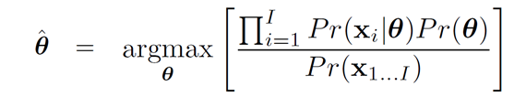
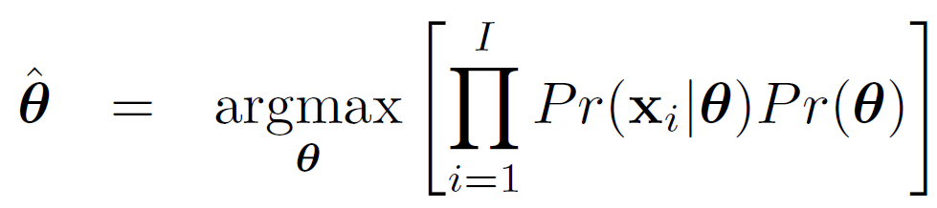
最大后验概率方法(MAP)
拟合：如命题所述，寻找一组参数使得后验概率
最大。
上式中，分母与参数无关，所以简化为：
Notes:
maximum likelihood is a special case of maximum a posteriori where the prior is uninformative.

Slide 29
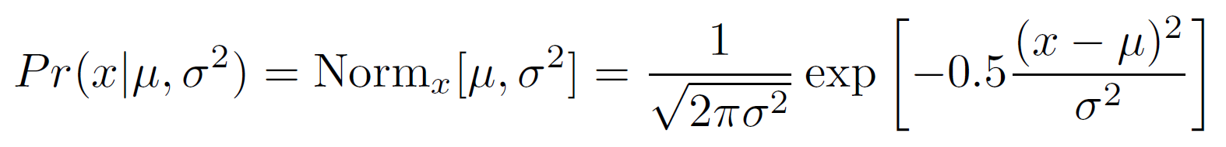
拟合正态分布：MAP
拟合：如命题所述，寻找一组参数使得后验概率
最大……
似然为正态分布PDF

Slide 30
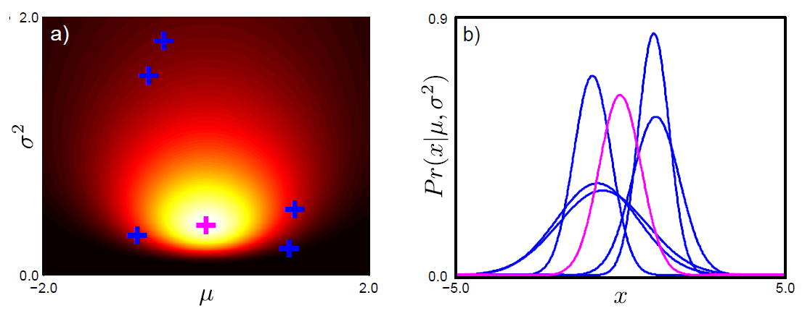
拟合正态分布：MAP
先验，使用共轭先验，正态逆伽马分布
Notes:
alpha = beta = gamma= 1; delta = 0.
Figure 4.4 Prior over normal parameters. a) A normal inverse gamma with α, β, γ = 1 and δ = 0 gives a broad prior distribution over univariate normal parameters. The magenta cross indicates the peak of the distribution. The blue crosses are 5 samples randomly drawn from the distribution. b) The samples and peak are visualized as the normal distributions they represent.

Slide 31
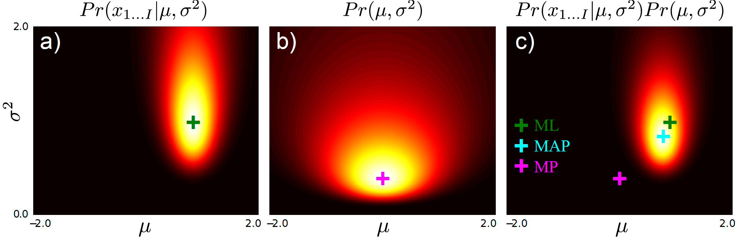
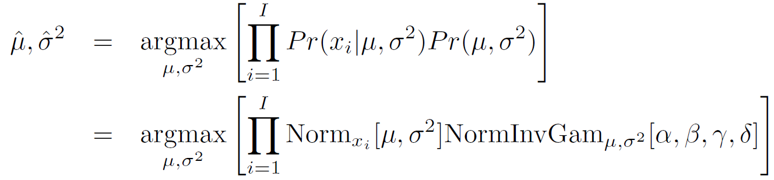
拟合正态分布：MAP
Likelihood
Prior
Posterior
Notes:
Figure 3.5 MAP inference for normal parameters. a) The likelihood function is multiplied by b) the prior probability to give a new function c) that is proportional to the posterior distribution. The maximum a posteriori (MAP) solution (blue cross) is found at the peak of the posterior distribution. It lies between the maximum likelihood (ML) solution (green cross) and the maximum of the prior distribution (MP, purple cross).

Slide 32
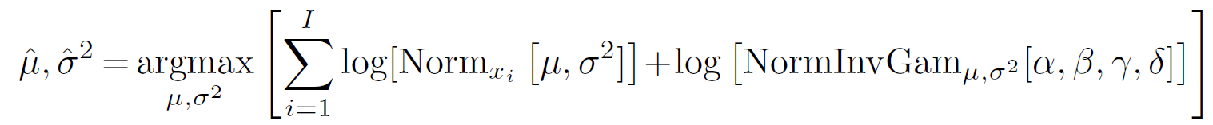
拟合正态分布：MAP
取对数log--不会改变最大值位置

Slide 33
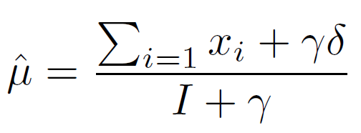
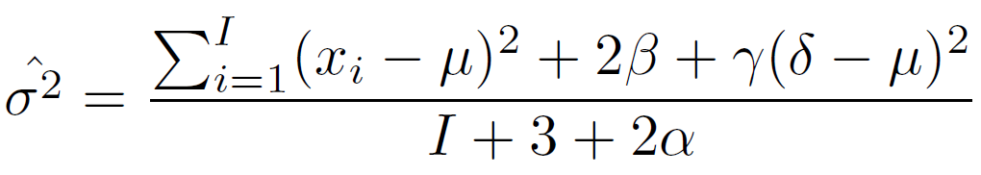
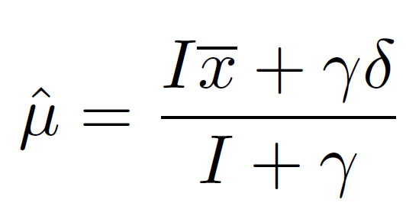
拟合正态分布：MAP
MAP 解为:
均值重写为数据均值与先验均值的加权和：
Notes:
This gives some insight into the behaviour of the MAP estimate (figure 3.6). With a large amount of data, the first term dominates and the MAP estimate ˆμ is very close to the data mean (and the ML estimate). With intermediate amounts of data, the ˆμ is a weighted sum of the prediction from the data and the prediction from the prior. With no data at all, the estimate is completely governed by the prior. The hyperparameter (parameter of the prior) γ controls the concentration of the prior with respect to μ and determines the extent of its influence. Similar
conclusions can be drawn about the MAP estimate of the variance.
Where there is a single data point (figure 3.6e-f), the data tells us nothing about the variance and the maximum likelihood estimate ˆσ2 is actually zero; the best fit is an infinitely thin and infinitely tall normal distribution centered on the one data point. This is unrealistic, not least because it accords the datum an infinite likelihood. However, MAP estimation is still valid as the prior ensures that sensible parameter values are chosen.

Slide 34
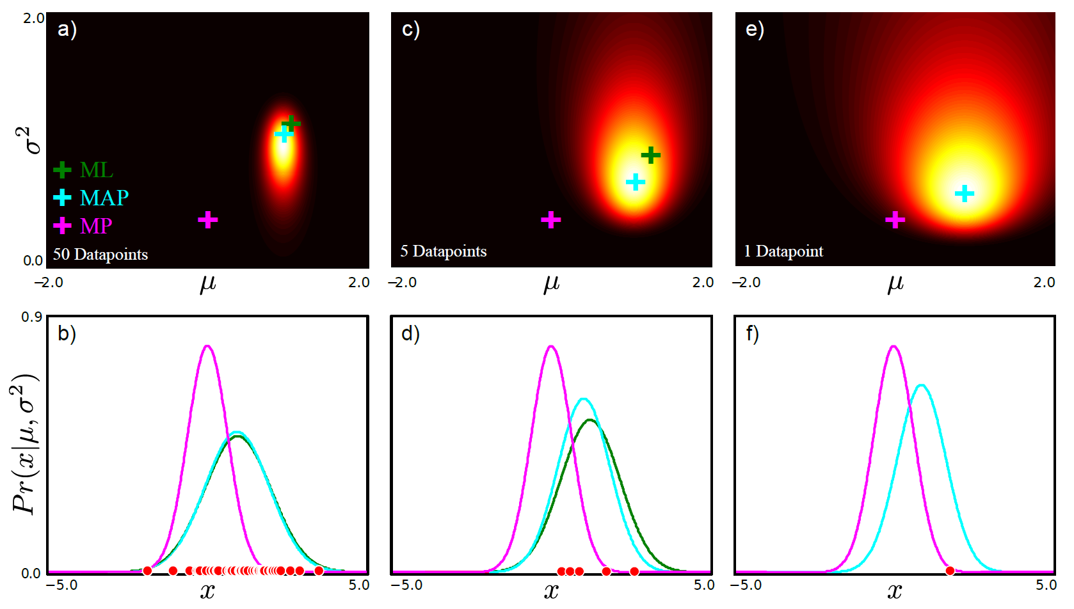
拟合正态分布：MAP
50 data points
5 data points
1 data points
Notes:
Figure 4.6 Maximum a posteriori estimation.
a) MAP solution (blue cross) lies between ML (green cross) and the peak of the prior (purple cross).
b) Normal distributions corresponding to MAP solution, ML solution and peak of prior.
c-d) With fewer data points, the prior has a greater effect on the final solution.
e-f) With only one datapoint, the maximum likelihood solution cannot be computed (you cannot calculate the variance of a single point). However, the MAP solution can still be calculated.

Slide 35

最大后验(MAP)
预测密度：
基于通过MAP方法学习到的参数模型，计算新的数据 的概率分布预测值
$$P_{r}\left(x^{∗} | \hat{θ}\right)={Norm}_{x}\left[\hat{μ},{\hat{σ}}^{2}\right]=\frac{1}{\sqrt{2π{\hat{σ}}^{2}}}exp⁡[−0.5\frac{{(x^{∗}−\hat{μ})}^{2}}{{\hat{σ}}^{2}}]$$

Slide 36


3. 贝叶斯方法
拟合:
基于所有可能的参数$值θ$，使用Bayes公式，计算后验分布；所有可能的参数值用其概率密度表示：
思想：任何参数值对数据样本都可能产生影响（贡献），为何只选择一组参数值？有多组参数都可以解释数据，尝试使用所有可能的参数。
Notes:
In the Bayesian approach we stop trying to estimate single fixed values (point estimates) of the parameters θ and admit what is obvious; there may be many values of the parameters that are compatible with the data. We compute a probability distribution Pr(θ|x1...I ) over the parameters θ based on data {xi}Ii =1 using Bayes’ rule so that

Slide 37

贝叶斯方法
预测密度
每一个可能的参数做出一种预测
某些参数下预测的概率要高于其它参数的预测
对新数据的最终预测是对每个参数预测的加权和（积分），权值为对应参数的概率密度。

Slide 38

正态分布拟合:贝叶斯方法
拟合：
使用Bayes公式计算后验分布， 参数分布为：
Notes:
In the Bayesian approach we calculate a posterior distribution Pr(μ, σ2|x1...I) over possible parameter values using Bayes’ rule,

Slide 39

正态分布拟合:贝叶斯方法
拟合：使用Bayes公式计算后验分布， 参数分布为：
两个常数必须删掉，否则等式左边项将不是一个合理的pdf。
Notes:
第二行到第三行的推导，参见习题3.11答案，可以从试凑的角度理解。

Slide 40

正态分布拟合:贝叶斯方法
拟合：使用Bayes公式计算后验分布， 参数分布为：
式中，

Slide 41


正态分布拟合:贝叶斯方法
预测密度
为不同参数值下模型预测值得加权和：
Posterior
Samples from posterior
Notes:
Figure 3.7 Bayesian predictions. a) Posterior probability distribution over parameters. b) Samples from posterior probability distribution correspond to normal distributions. c) The predictive distribution for the Bayesian case is the average of an infinite set of samples. Alternately, we can think of choosing the parameters from a uniform distribution and computing a weighted average where the weights correspond to the posterior distribution.

Slide 42

正态分布拟合:贝叶斯方法
预测密度
为不同参数值下模型预测值得加权和：

Slide 43


正态分布拟合:贝叶斯方法
预测密度
为不同参数值下模型预测值的加权和：
式中，

Slide 44

正态分布拟合:贝叶斯方法
50 data points
5 data points
1 data points
Notes:
Figure 3.8 a-c) Predictive densities for MAP and Bayesian approaches with 50, 5 and 1 training example. As the training data decreases, the Bayesian prediction becomes less certain but the MAP prediction is erroneously overconfident. d-f) This effect is even more clear on a log scale.

Slide 45


参数学习的3种方法对比
Maximum a posteriori:
Bayesian:
Notes:
关于参数学习的对比与理解

Slide 46
三种方法的预测密度对比
ML:
基于ML得到的分布参数，计算新数据 的概率分布
MAP：
基于通过MAP方法学习到的参数模型，计算新的数据
的概率分布预测值
Bayesian:
不同参数值下模型预测值之加权和：
Notes:
关于预测的对比与理解

Slide 47


三种方法的预测密度对比
如何理解三种方法不同的形式？
可以将ML和MAP估计视为除了估计的（$\hat{θ}$）外，θ的其它位置点概率密度取0值（即，delta function）

Slide 48
本章结构
拟合概率分布(Fitting probability distributions)
最大似然（Maximum likelihood）
最大后验（Maximum a posteriori）
贝叶斯方法（Bayesian approach）
实例之一，正态分布
实例之二，分类分布
48
Notes:
This chapter concerns fitting probability models to data {xi}Ii =1. This process is referred to as learning because we learn about the parameters θ of the model1. It also concerns calculating the probability of a new datum x∗ under the resulting model. This is known as evaluating the predictive distribution. We consider three methods: maximum likelihood, maximum a posteriori and the Bayesian approach.

Slide 49






分类分布 （Categorical Distribution）
可以视为：矢量除第k个元素外，其余都为0，即 e₄ = [0,0,0,1,0]
简记为：
分类分布描述有K种可能的情况 y=1,y=2,… ,y=K.
有K 个参数
2016/9/19
计算机视觉：模型、学习和推理
49

Slide 50



狄利克雷分布(Dirichlet Distribution)
K个随机变量 ，这里
有 k个参数
α_{k}>0
参数的比例决定分布的的期望值，参数的绝对值决定分布的集中程度。
简记为:
2016/9/19
计算机视觉：模型、学习和推理
50

Slide 51


1. 分类分布: ML拟合
最大化似然：
N_{k} = # times we
observed bin k
注意,

Slide 52


分类分布: ML拟合
以对数概率最大化替代：
拉格朗日乘子保证参数之和为1
对数似然
求导、置导数为零，并整理为：

Slide 53


2. 分类分布： MAP拟合
MAP 准则:
Notes:
从第二行到第三行，应该是将与参数$λ_{k}$无关的部分省略了，因为是求$λ_{k}$取何值时，目标函数最大。

Slide 54

分类分布： MAP拟合
求导、置导数为零，并整理得：
对于均匀分布的先验 (a_{1..K}=1), 得到与最大似然相同的结果。

Slide 55

3. 分类分布：Bayesian approach
计算参数的后验分布：
为保证等式左边是有效的pdf，两个常数项必须抵消。
Notes:
推导参见习题答案3.10，也是凑出的。

Slide 56


分类分布：Bayesian approach
预测分布计算：

Slide 57


分类分布(Categorical Distribution)
超参数α1...6 = 1的参数先验分布的5个采样结果图示
观测数据
参数的Dirichlet后验分布的5个采样结果图
Notes:
3.5.2 Maximum a posteriori
This prior over the six categorical parameters is hard to visualize but samples can be drawn and examined (figure 3.10a-e).
3.5.3 Bayesian Approach
Samples from this distribution are shown in figure 3.10f-j.
Figure 3.10 a-e) Five samples drawn from Dirichlet prior with hyperparameters. This defines a uniform prior, so each sample looks like a random unstructured probability distribution. f-j) Five samples from Dirichlet posterior. The distribution favours histograms where bin three is larger and bin four is small as suggested by the data.

Slide 58

ML / MAP vs. Bayesian
MAP/ML
Bayesian

Slide 59
总结
3种概率拟合方法
Maximum likelihood
Maximum a posteriori
Bayesian Approach
2个分布实例
Normal distribution (ML→ least squares)
Categorical distribution
Notes:
We presented three ways to fit a probability distribution to data and to predict the probability of new points. Of the three methods discussed, the Bayesian approach is the most desirable. Here it is not necessary to exactly estimate the parameters and so errors are not introduced because the point estimate is wrong.
However, the Bayesian approach is only tractable when we have a conjugate prior, which makes it easy to calculate the posterior distribution over the parameters Pr(θ|x1...I ) and also to evaluate the integral in the predictive density. When this is not the case, we will usually have to rely on maximum a posteriori estimates. Maximum likelihood estimates can be thought of as a special case of maximum a posteriori estimates in which the prior is uninformative.

Slide 60

算法练习
教材配套《Algorithm booklet》
算法4.1~4.6
ML和MAP方法不需要给出推理式，直接将估计参数代入概率密度式即可计算新数据的概率估计值；
Bayes方法需要得到推理式，才能得到$P_{r}\left(x^{∗}\right).$
实验数据
正态分布和分类分布的随机变量
用C++语言，至少实现2个算法，建议使用STL的内容。
建议2~3周内提交作业

